Slide 1
5) Factor Analysis (with Key Driver Application)

Slide 2
Example:
An automobile manufacturer is interested in attitudinal characteristics impacting purchase of a new type of performance car. A survey was performed (n=400) and attitudinal measures were obtained on a 9 point scale (1= definitely disagree to 9= definitely agree), along with responses to a purchase intent question measured on a scale from 0 (definitely would not purchase) to 100 (definitely would purchase). Below are the attitudinal questions. (data in SPSS file CarStudyPsyc.sav)

Slide 3
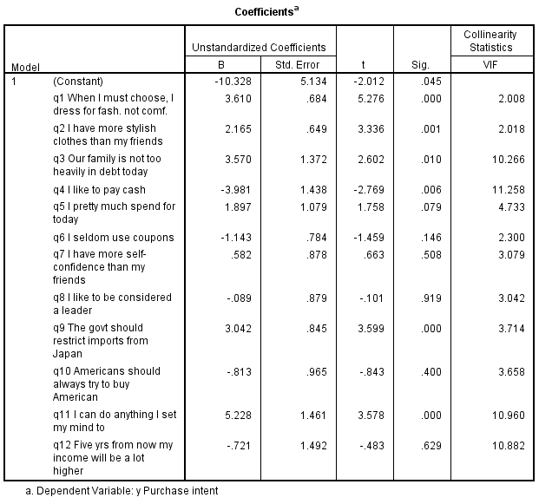
A multiple regression with purchase intent as the dependent variable produced the following.

Slide 4
Correlations of the explanatory variables

Slide 5
There is evidence of multicollinearity, and as we saw before, mulitcollinearity can interfere with our ability to obtain useful measures of the predictor variables impact on the dependent variable.
A common remedial measure that was mentioned briefly in topic 3 is to perform the regression on composite measures, where the composites are a reduced set of explanatory variables formed from the original set, that have little or no correlations among themselves.
Factor analysis is a methodology that can be used to identify and create such composite measures.

Slide 6
Factor analysis is a methodology that identifies the underlying structure and interrelationships among variables. It has many uses:
determining whether and how a data set can be described with a reduced set of composite measures.
summarizing and simplifying the representation of data sets.
as a preliminary step to other procedures that include regression, segmentation, and discriminant analysis

Slide 7
There are different types of factor analysis. We will cover a common approach used in business applications called Principal Components Factor Analysis
Solve for the linear equations such that the first factor explains as much of the data variation as possible, the second factor explains as much of the remaining variation as possible while being uncorrelated with the first factor, etc.
There will be as many factors as X variables. However, some factors may not be very informative and may be dropped.

Slide 8
The appropriate number of factors can be determined by
-Prior knowledge
-Eigenvalues- There is an eigenvalue associated with each factor. The eigenvalue indicates the total
amount of variance attributed to the associated factor. The total amount of variance in the data is given by the sum of all the eigenvalues– which equals the number of variables (since we are dealing with standardized variables, the variance of any one variable = 1)The general rule is to retain only those factors with eigenvalues > 1.
-Cumulative percentage of variance
Communalities- The proportion of the variance of each variable that is explained by the selected factors

Slide 9
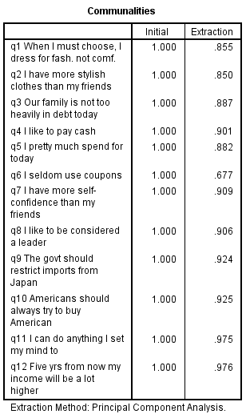
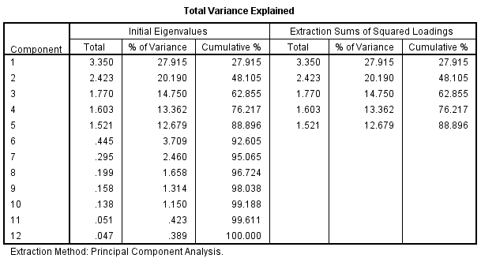
For our example:

Slide 10
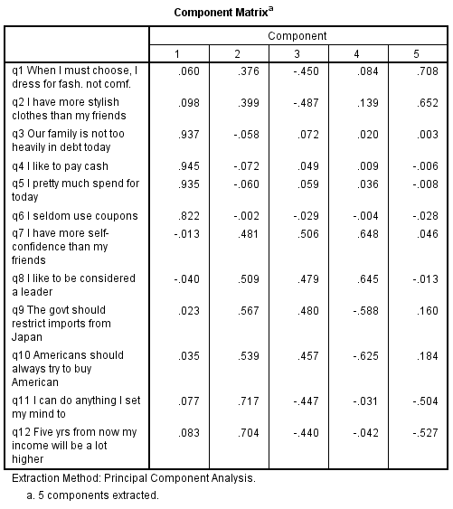
Important output from the factor analysis is the matrix of factor loadings (component matrix in SPSS). Factor loadings are the correlations between the variables and the associated factors. These can be useful for interpretation.
The original or unrotated matrix is sometimes not very informative.

Slide 11
Varimax is a common method of factor rotation.
It is an orthogonal rotation procedure (axes kept at right angles), and works to simplify the factors.
Note that rotation does not affect percentage of total variance explained, nor the communalities.

Slide 12
Rotation of Factors
Unrotated F2
Rotated F2
V1
V2
Unrotated F1
V3
V4
Rotated F1

Slide 14
Summarizing the steps in Principal Components Factor Analysis
1) Obtain the components.
2) Determine which components to retain
3) Perform rotation.
4) Interpret and use the results.

Slide 15
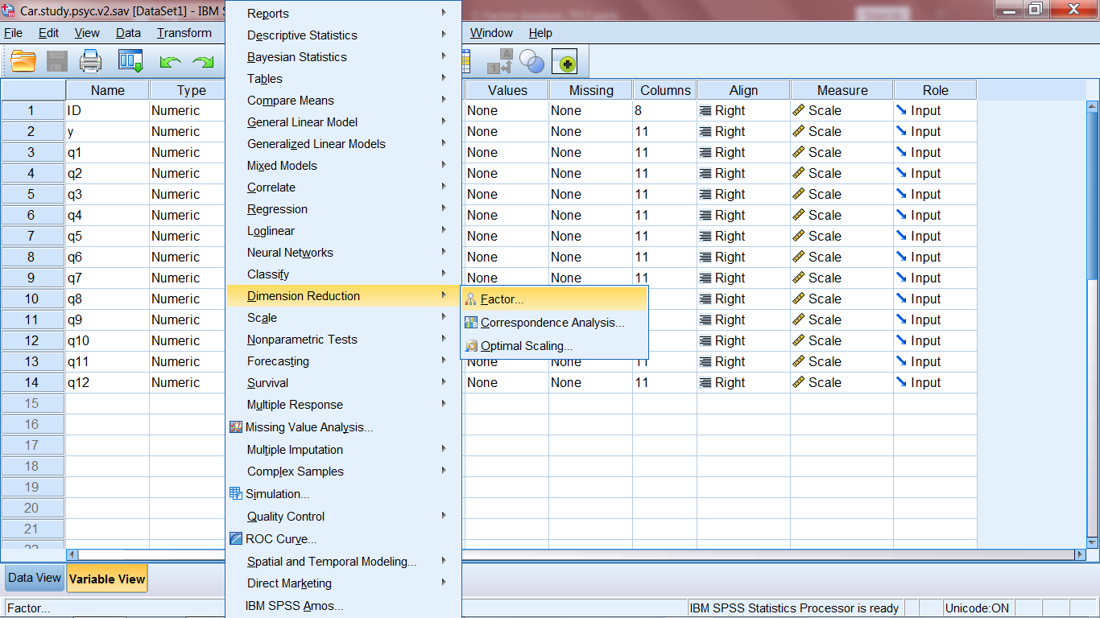
SPSS Screen Shots for Principal Components Factor Analysis

Slide 16
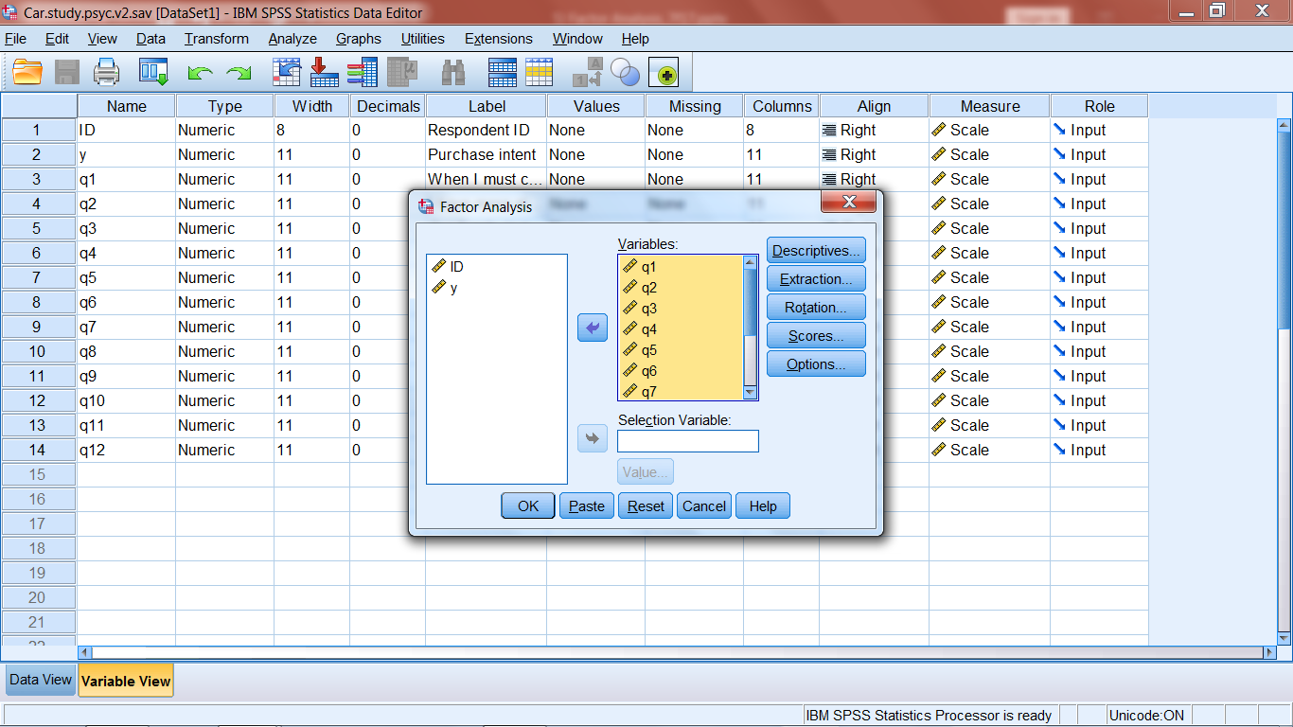

Slide 17
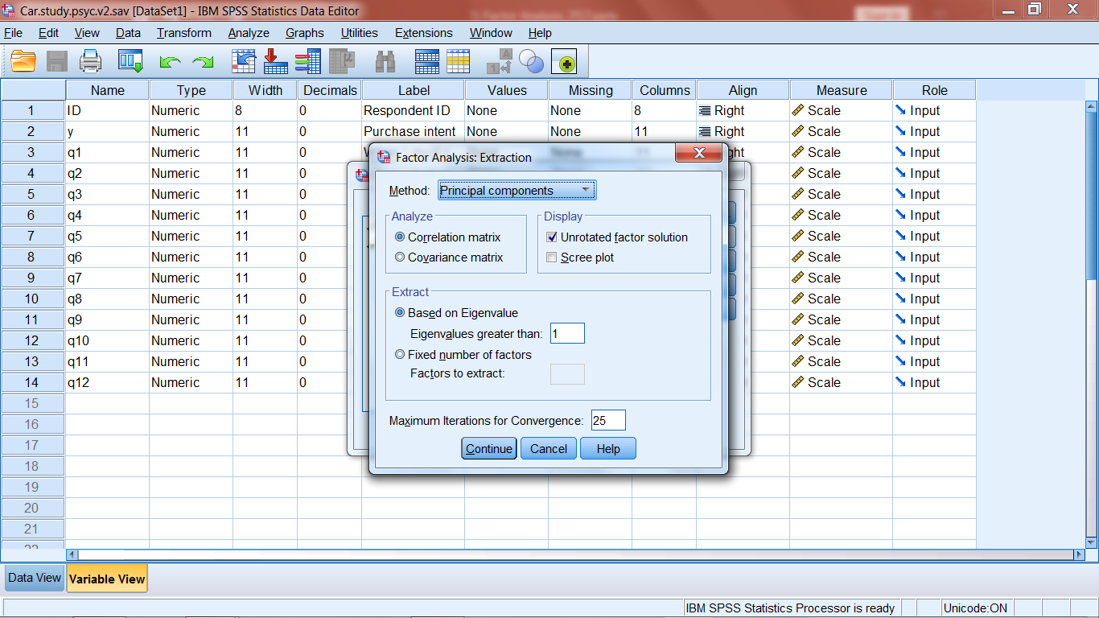

Slide 18
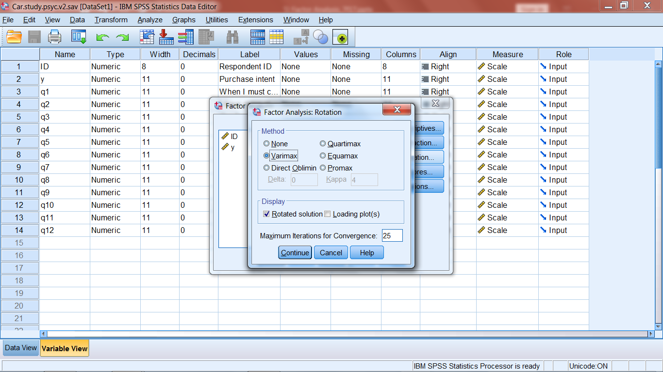

Slide 19
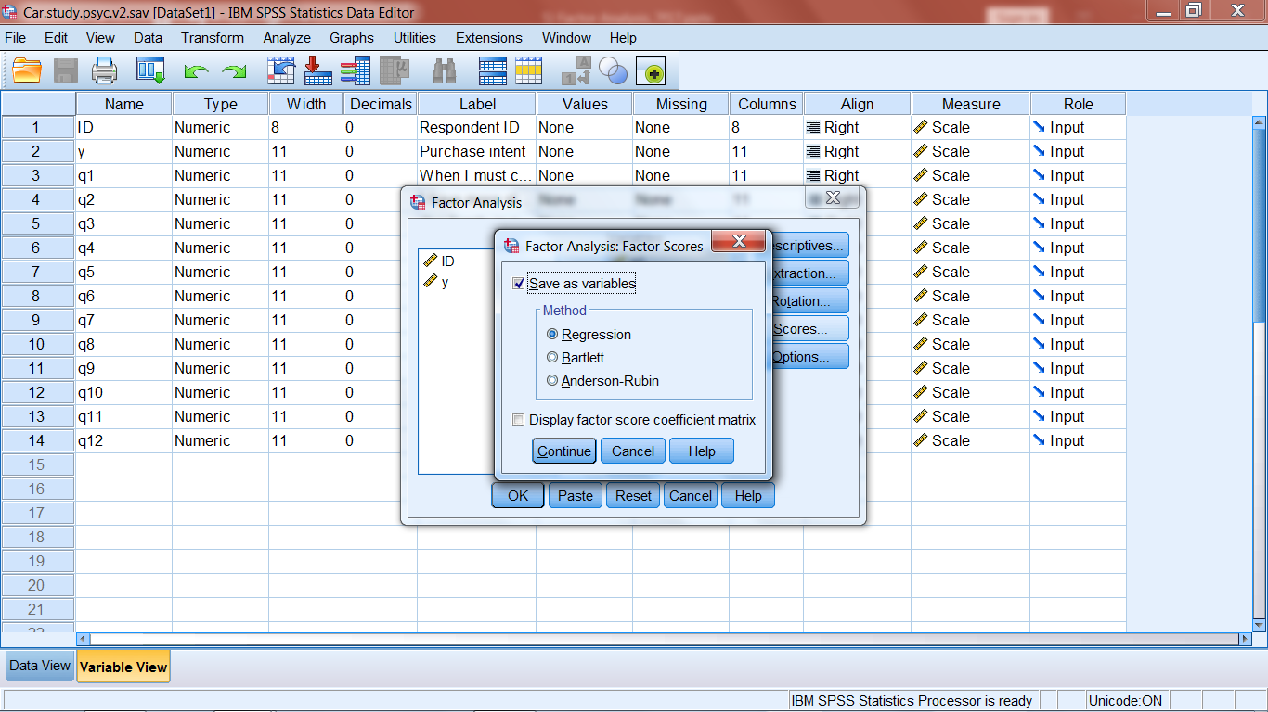

Slide 20
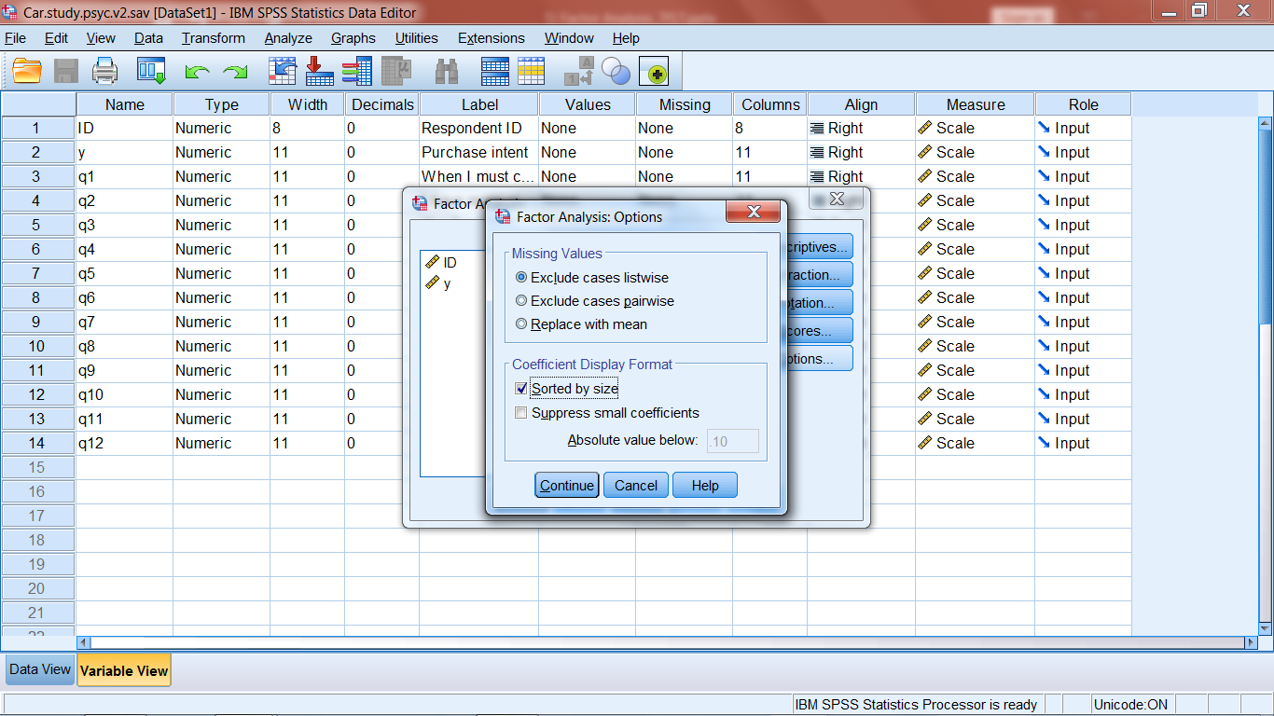

Slide 21
For our regression /driver application, we want to obtain a reduced set of attitudinal measures that are not highly correlated among themselves. Using factor analysis, several alternatives used in practice are:
-Select surrogate variables - singling out representative variables for the factors
-Build composites based on major variables on each factor-e.g., simple averages
-Use the factor scores--recall these are linear functions of the original variables

Slide 22
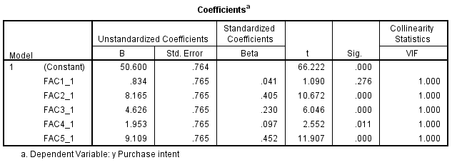
Using the factors as explanatory variables in our regression application produces the following:

Slide 23
Added Application
An electric utility company is interested in conducting an analysis among residential customers to determine the drivers of customer satisfaction. In addition to an overall satisfaction question (measured on a 0 to 100 point scale from Extremely Dissatisfied to Extremely Satisfied), eleven performance measures were obtained (measured on a 0 to 10 point scale from Strongly Disagree to Strongly Agree).
q1 Provides accurate bills
q2 Shows concern and caring with customer interactions
q3 Keeps rates low
q4 Provides easy to understand bills
q5 Provides reliable repairs
q6 Does things right the first time
q7 Responsive to complaints/requests
q8 Preserves the environment
q9 Short service interruptions
q10 Has reasonable rates
q11 Good corporate citizen
Estimate a regression model to provide information about the drivers of satisfaction. Data file ElecUtilityCostudy.sav contains the 1000 observations on the variables q1 to q11 and OS (overall sat).

Slide 24
SAS Code for PCA Factor Analysis
proc import datafile="D:\_UGA\7600\CarStudyPsyc.sav" DBMS=SAV OUT=csp;
run;
proc factor data=csp method=principal rotate=varimax reorder nfactors=5 out=fscores; Var q1-q12;
Run;
*Reorder sorts the loadings, file fscores contains the factor variables;
Proc reg data=fscores;
Model y=factor1 factor2 factor3 factor4 factor5/stb vif;
Run;

